Slide 1
IMD Measurement POC Audio Plug-in Offering

Slide 2
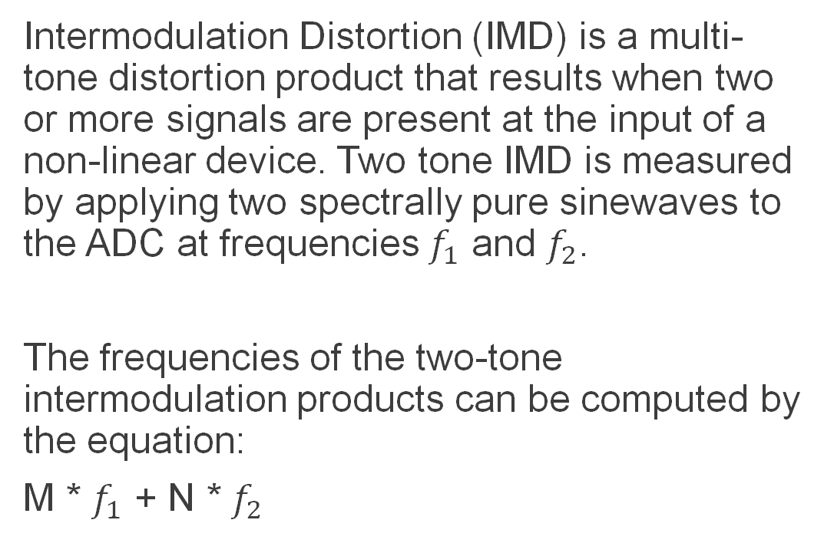
What is IMD Measurement ?
Intermodulation Distortion (IMD) is a multi-tone distortion product that results when two or more signals are present at the input of a non-linear device. Two tone IMD is measured by applying two spectrally pure sinewaves to the ADC at frequencies $f_{1}$ and $f_{2}$.
The frequencies of the two-tone intermodulation products can be computed by the equation:
M * $f_{1}$ + N * $f_{2}$

Slide 3
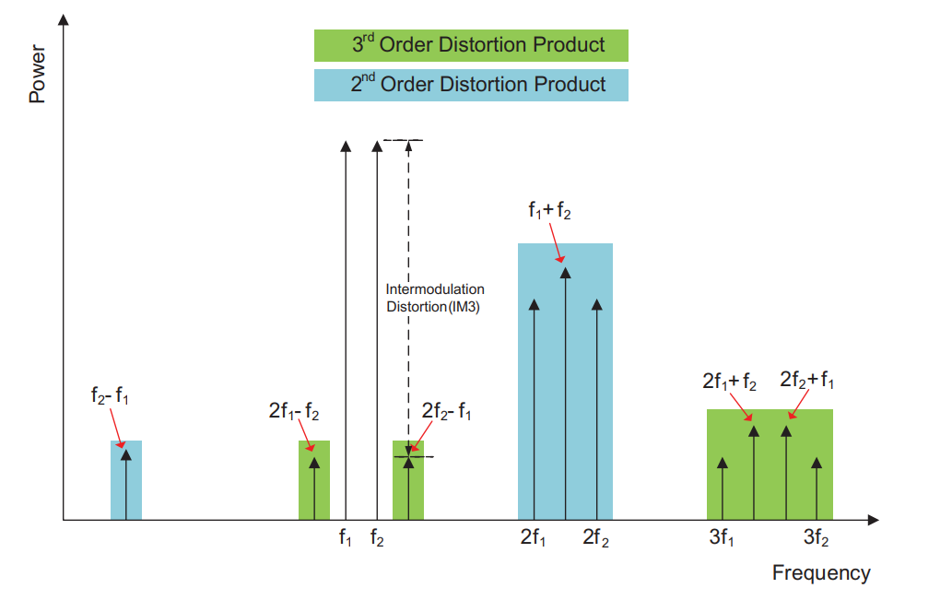
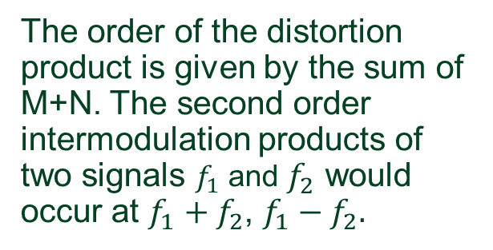
IMD Measurement
The order of the distortion product is given by the sum of M+N. The second order intermodulation products of two signals $f_{1}$ and $f_{2}$ would occur at $f_{1}+f_{2}$, $f_{1}−f_{2}.$

Slide 4
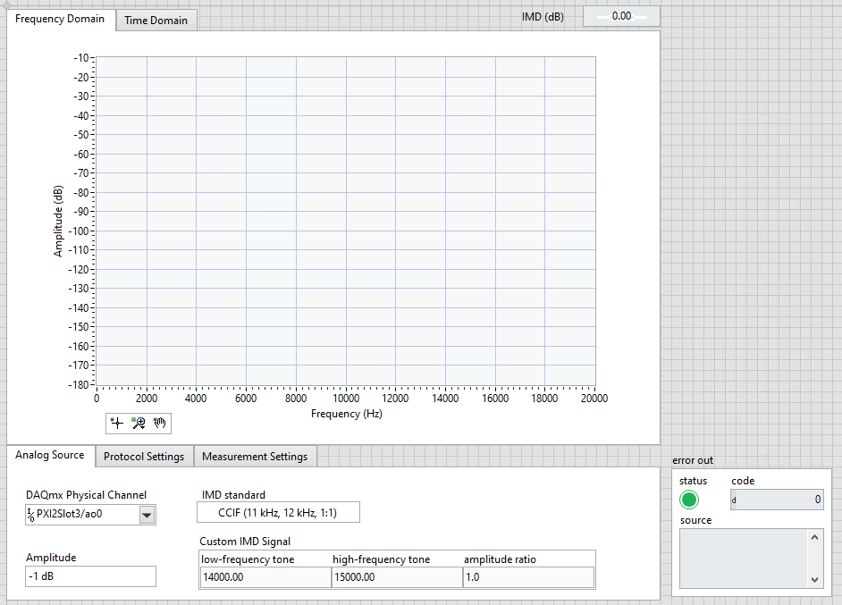
UI for the POC
IMD Standards provided are
SMPTE (60 Hz, 7000 Hz, 4:1)
DIN (250 Hz, 8000 Hz, 4:1)
CCIF (11 kHz, 12 kHz, 1:1)
CCIF (19 kHz, 20kHz, 1:1)
Custom IMD

Slide 5
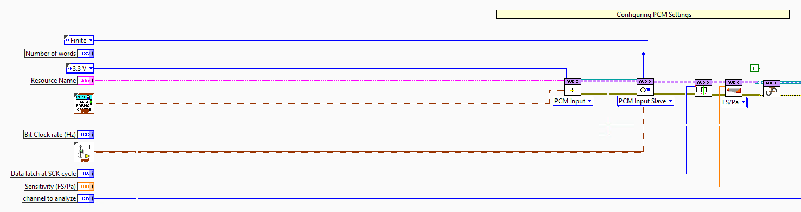
Logic for POC
Configuring PCM Settings

Slide 6
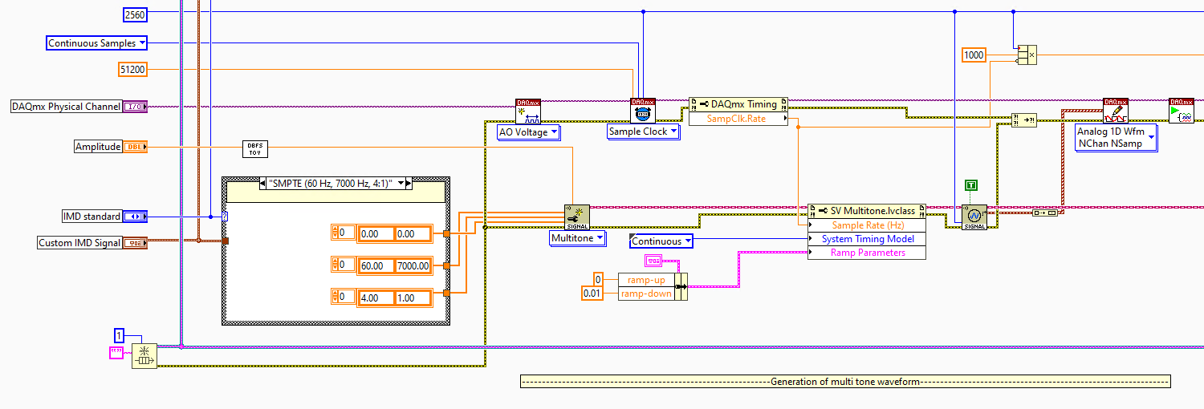
Logic for POC
Generate multi tone waveform

Slide 7
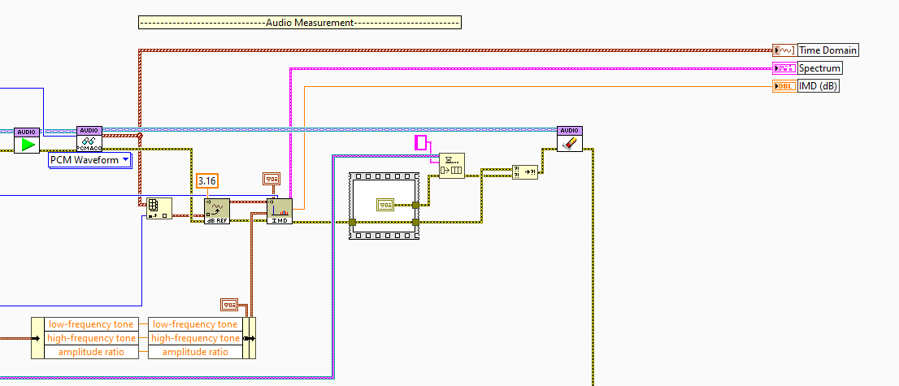
Logic for POC
Perform Audio Measurements (IMD)

Slide 8
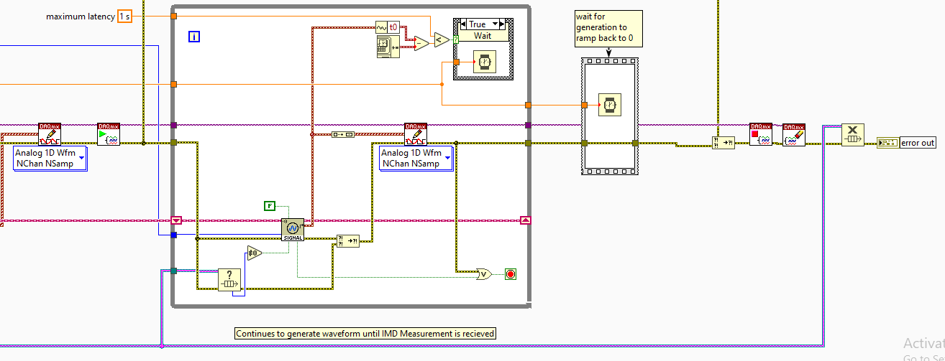
Logic for POC
Generate multi tone waveform (Generates until measurement is taken)

Slide 9
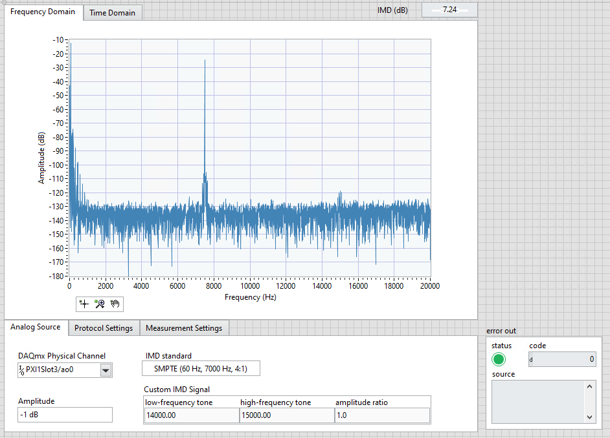
Results for POC

Slide 10
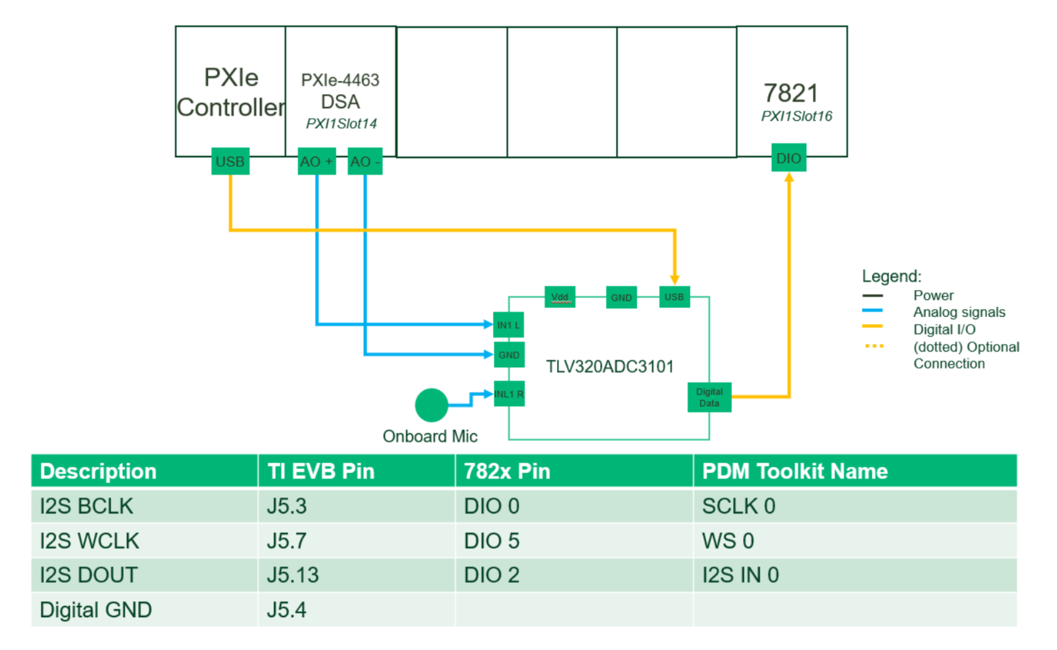
Test Setup for demo

Slide 11
Demo

